Slide 1
CPE 133
Foundation Modeling Design Overview
Experiment 14
Example Problems

Slide 2
Foundation Modules
Comparator
RCA
Register
Generic Decoder
Counter
Standard Decoder
Shift Register
4:1 MUX

Slide 3
Design Problems/Solutions: Mathematical Operations
Operation | Hardware
Accumulate List of numbers
Number of events
Addition/Subtraction
Multiplication
By 2^{n}
By any number
Division
By 2^{n}
By any number

Slide 4
Design Problems/Solutions: Mathematical Operations
Operation | Hardware
Accumulate List of numbers | Accumulator (RCA & Register)
Number of events | Counter
Addition/Subtraction | RCA
Multiplication
By 2^{n} | Shift Register (shift left)
By any number | Repeated addition (accumulator)
Division
By 2^{n} | Shift Register (shift right)
By any number | Repeated subtraction (accumulator)

Slide 5
Design Problems/Solutions: Miscellaneous Operations
Operation | Hardware
Delays (do same thing for awhile)
Fixed delay (a few)
Fixed delay (many)
Event controlled
Logic
Simple
Complex
Decision (select one of several)

Slide 6
Design Problems/Solutions: Miscellaneous Operations
Operation | Hardware
Delays (do same thing for awhile)
Fixed delay (a few) | FSM states
Fixed delay (many) | Counter with RCO
Event controlled | FSM self-loop
Logic
Simple | Gates
Complex | Decoder (LUT)
Decision (select one of several) | MUX

Slide 7
Design Problems/Solutions: More Miscellaneous Operations
Operation | Hardware
Comparisons General Without Comparator Greater than? Less than?
Bit Operations Odd/Even Negative/Positive Evenly divisible by 2^n

Slide 8
Design Problems/Solutions: More Miscellaneous Operations
Operation | Hardware
Comparisons General Without Comparator Greater than? Less than? | Comparator Are upper bits set? Are upper bits cleared?
Bit Operations Odd/Even neg/pos Evenly divisible by 2^n | LSB set/cleared Sign bit set/cleared Lower n-bits cleared

Slide 9
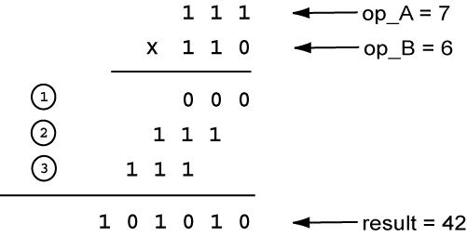
Experiment #14 FSM Based 5-Bit Multiplier
Multiplication by adding/shifting
3-bit multiply example:

Slide 10
Experiment #14 FSM Based 5-Bit Multiplier
Design cries out for registers
Simple registers to store values
“accumulator” to store running result total
Shift register for “shifting”
Also
Use univ_sseg.v for output
Use clock divider to view operation
Use one LED per state for debugging (maybe)

Slide 11
Design Problem #1:
Provide a state diagram that models a 2-bit right shifting shift register.
The shift register has one data input D
The shift register has a H input (hold) that prevents the circuit from changing state when asserted.
The shift register has an asynchronous RESET input that puts the shift register to the “00” state.
Input precedence (hi to low): RESET, H

Slide 12
Design Problem #2:
Provide a state diagram that models a 2-bit shift register.
The shift register has one data input D
The shift register has a R input that causes a right shift when asserted or a left shift if not asserted.
The shift register has a H input (hold) that prevents the circuit from changing state when asserted.
The shift register has an asynchronous RESET input that puts the shift register to the “00” state.
Input precedence (hi to low): RESET, H, R

Slide 13
Design Problem #3:
Design a circuit that upon a button press, accumulates the 8-bit unsigned binary input. Each clock cycle, it potentially adds the input to the running total. The circuit continues to operate until a the accumulated value exceeds the 8-bit output, at which time it stops, displays the total, and waits for another button press.
The input value that exceeds the 8-bit output is not added to the circuit.
Show a BBD supporting your solution.
Use an FSM in your design and provide a state diagram modeling that FSM
State how the circuit is controlled

